Slide 1
Chapter 1
Entrepreneurship
and the
Entrepreneurial Mind-Set
McGraw-Hill/Irwin
Copyright © 2010 by The McGraw-Hill Companies, Inc. All rights reserved.

Slide 2
Nature and Development of Entrepreneurship
Entrepreneur – An individual who takes initiative to bundle resources in innovative ways and is willing to bear the risk and/or uncertainty to act.
Being an entrepreneur today:
  Involves creation process.
  Requires devotion of time and effort.
  Involves rewards of being an entrepreneur.
  Requires assumption of necessary risks.

Slide 3
Nature and Development of Entrepreneurship (cont.)
Entrepreneurial action - Behavior in response to a judgmental decision under uncertainty about a possible opportunity for profit.

Slide 4
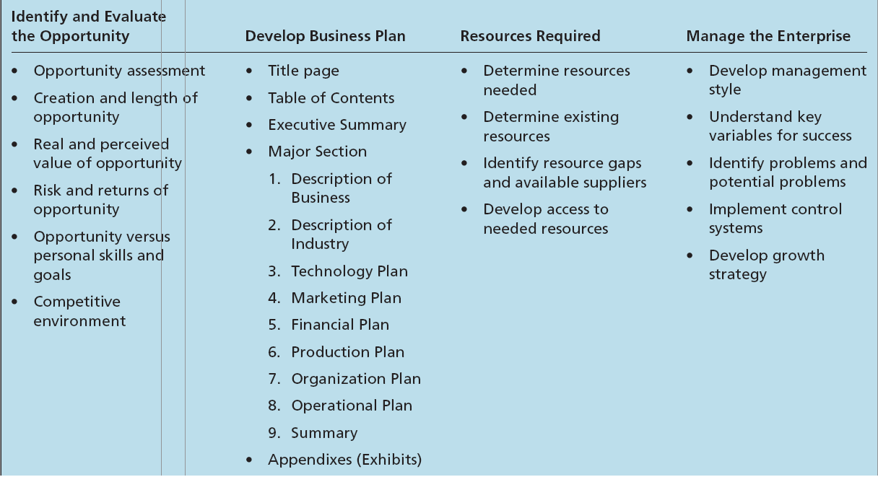
Table 1.1 - Aspects of the Entrepreneurial Process

Slide 5
The Entrepreneurial Process
Opportunity identification - The process by which an entrepreneur comes up with the opportunity for a new venture.
Market size and the length of the window of opportunity are the primary bases for determining risks and rewards.
Window of opportunity - The time period available for creating the new venture.
Business plan - The description of the future direction of the business.

Slide 6
How Entrepreneurs Think
Entrepreneurs in particular situations may think differently when faced with a different task or decision environment.
Given the nature of their decision-making environment, entrepreneurs need to sometimes:
  Effectuate.
  Be cognitively adaptable.
  Learn from failure.

Slide 7
How Entrepreneurs Think (cont.)
Causal process
  Starts with a desired outcome.
  Focuses on the means to generate that outcome.
Effectuation process
  Starts with what one has (who they are, what they know, and whom they know).
  Selects among possible outcomes.
Entrepreneurial mind-set involves the ability to rapidly sense, act, and mobilize, even under uncertain conditions.

Slide 8
How Entrepreneurs Think (cont.)
Cognitive adaptability describes the extent to which entrepreneurs are:
  Dynamic, flexible, self-regulating and engaged in the process of generating multiple decision frameworks focused on sensing and processing changes in their environments and then acting on them.
It reflects in an entrepreneur’s metacognitive awareness.

Slide 9
How Entrepreneurs Think (cont.)
  Achieving cognitive adaptability
    Comprehension questions – Aids understanding of the nature of the environment before addressing an entrepreneurial challenge.
    Connection tasks – Stimulates thinking about the current situation in terms of similarities and differences with situations previously faced and solved.
    Strategic tasks – Stimulates thoughts about which strategies are appropriate for solving the problem (and why) or pursuing the opportunity (and how).
    Reflection tasks – Stimulates thinking about their understanding and feelings as they progress through the entrepreneurial process.

Slide 10
How Entrepreneurs Think (cont.)
  Entrepreneurs who are able to increase cognitive adaptability have an improved ability to:
    Adapt to new situations.
    Be creative.
    Communicate one’s reasoning behind a particular response.

Slide 11
How Entrepreneurs Think (cont.)
Learning from Business Failure
  Uncertainty, changing conditions, and insufficient experience can contribute to failure among entrepreneurial firms.
  An entrepreneur’s motivation is not simply from personal profit but from:
    Loyalty to a product.
    Loyalty to a market and customers.
    Personal growth.
    The need to prove oneself.

Slide 12
How Entrepreneurs Think (cont.)
  Loss of a business can result in a negative emotional response from the entrepreneur.
  It can interfere with:
    Entrepreneur’s ability to learn from the failure.
    Motivation to try again.

Slide 13
How Entrepreneurs Think (cont.)
Recovery and Learning Process
  Emotional recovery from failure happens when thoughts about the events surrounding, and leading up to the loss of the business, no longer generate a negative emotional response.
  Primary descriptions of the process of recovering are:
    Loss-orientation.
    Restoration-orientation.

Slide 14
How Entrepreneurs Think (cont.)
  Loss-Orientation
    Involves working through, and processing, some aspect of the loss experience and, as a result of this process, breaking emotional bonds to the object lost.
    This process gradually provides the loss with meaning and eventually produces a changed viewpoint.
    Involves confrontation, which is physically and mentally exhausting.
    Characterized by feelings of relief and pain that wax and wane over time.

Slide 15
How Entrepreneurs Think (cont.)
  Restoration-Orientation
    Based on both avoidance and a proactiveness toward secondary sources of stress arising from a major loss.
    Involves suppression, which requires mental effort and presents potentially adverse consequences for health.
    Provides an opportunity to address secondary causes of stress.
    May reduce emotional significance of the loss.

Slide 16
How Entrepreneurs Think (cont.)
A Dual Process for Learning from Failure
  The dual process of oscillating between the loss-orientation and restoration-orientation enables a person to:
    Obtain the benefits of each.
    Minimize the costs of maintaining one for too long.
  This dual process speeds the recovery process.

Slide 17
How Entrepreneurs Think (cont.)
  Practical implications of the dual process:
    Knowledge that feelings and reactions being experienced are normal.
    Realizing that psychological and physiological outcomes caused by the feelings of loss are “symptoms” can reduce secondary sources of stress.
    There is a process of recovery to learn from failure, which offers some comfort that current feelings of loss will eventually diminish.
    Recovery and learning process can be enhanced by some degree of oscillation.
    Recovery from loss offers an opportunity to increase one’s knowledge of entrepreneurship.

Slide 18
Ethics and Social Responsibility of Entrepreneurs
Entrepreneurs usually develop an internal ethical code.
Personal value systems tend to be influenced by:
  Peer pressure.
  General social norms in the community.
  Pressures from their competitors.
Business ethics - The study of behavior and morals in a business situation.

Slide 19
Role of Entrepreneurship in
Economic Development
Innovation is depicted as a key to economic development.
  Product-evolution process - Process through which innovation is developed and commercialized.
  Iterative synthesis - The intersection of knowledge and social need that starts the product development process.

Slide 20
Role of Entrepreneurship in Economic Development (cont.)
Three types of innovation:
  Ordinary - New products with little technological change.
  Technological – New products with significant technological advancement.
  Breakthrough – New products with some technological change.

Slide 21
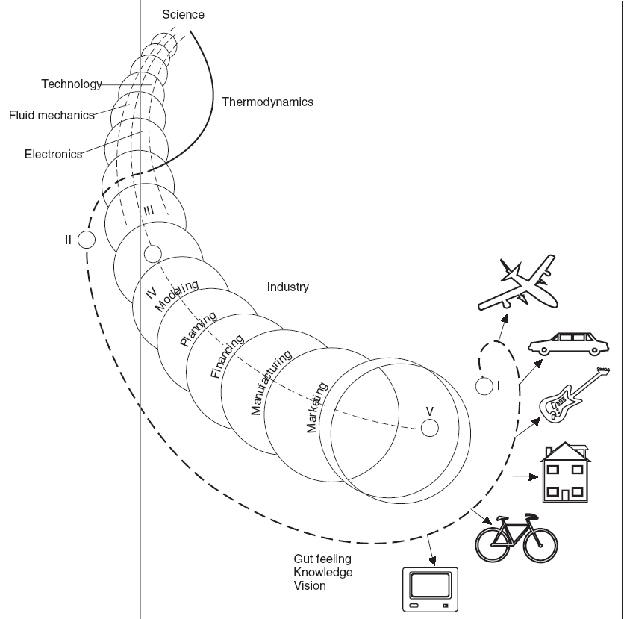
Figure 1.1 - Product Evolution

